Slide 1
Membership functions
Module IV
R5 Elective II
Soft Computing

Slide 2


Membership Functions
Membership functions characterize the fuzzyness in a fuzzy set.
Features of Membership Functions
Core of a Membership Function :-Core of a membership function for a fuzzy set A is defined as that region of universe that is characterized by complete or full membership in the set A. Therefore core consists of all those elements X of universe of discourse, such that

Slide 3

Cont…
Support of a Membership Function :-Support of a membership function for a fuzzy set A is defined as that region of universe that is characterized by non-zero membership in the fuzzy set A. So support consists of all those elements X of universe, such that

Slide 4

Cont…
Boundary of a Membership Functions :-Boundary of a membership function for a fuzzy set A is defined as that region of universe X, that is characterized by non-zero membership but not complete membership. Boundaries comprises that part of elements X of Universe of Discourse whose membership value is given by

Slide 5
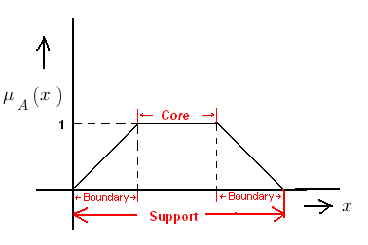
Core, Support and Boundary of a membership function representation

Slide 6

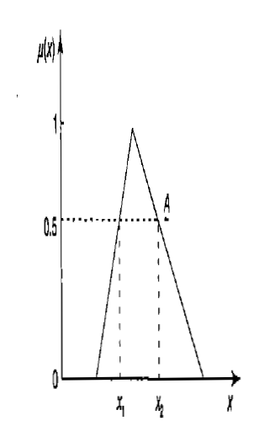
Cont…
Cross-over Points of a Membership Function :-It is defined as the elements of a fuzzy set A whose membership value is equal to 0.5

Slide 7
Height of a Membership Functions :- Height of a membership function is the maximum value of the membership function. If the height of a fuzzy set is < 1 then it subnormal fuzzy set. Whereas if its height is equal to 1 then it is a normal fuzzy set.

Slide 8
Cont…
Normal Fuzzy Set :-A normal fuzzy set is one that consists of at-least one element ‘x’ of universe whose membership value is unity. For fuzzy sets where only one element which has a membership value of unity, that particular element is called prototype of the fuzzy set or prototypical element.
Convex Fuzzy Set :-Convex fuzzy set is described by a membership function whose membership values are strictly Monotonically Increasing or Monotonically Decreasing or Initially Monotonically Increasing then Monotonically Decreasing with the increase in the values of the elements of that particular fuzzy set.

Slide 9
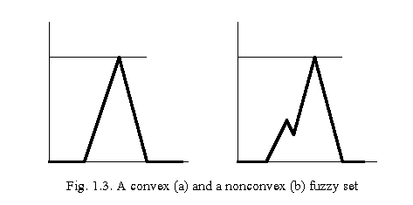
Cont…

Slide 10
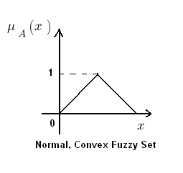
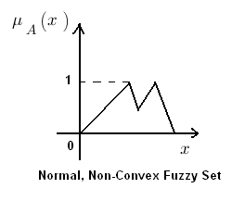
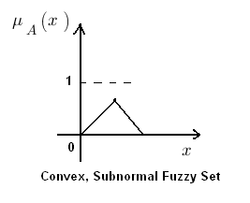
Cont…

Slide 11
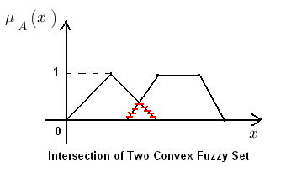
Cont…
The intersection of two convex fuzzy sets is also a convex fuzzy set.

Slide 12
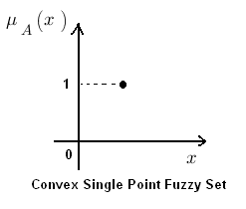
Cont…
Fuzzy Number :-If ‘A’ is a convex single point normal fuzzy set defined on real line, then ‘A’ is called Fuzzy Number.

Slide 13

Cont…
Fuzzification:-Fuzzification is the process of making a crisp quantity fuzzy. The reverse of this process is called anti-fuzzification or defuzzification.
a)Support fuzzification
b)Grade fuzzification
Q(x_{i})=Kernel of fuzzification

Slide 14
Methods of membership value assignments

Slide 15
Intuition
It is simply derived from the capacity of human to develop membership functions through their own innate intelligence and understanding.

Slide 16
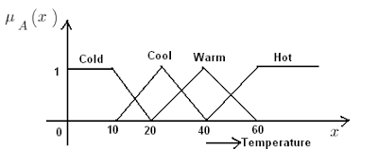
Cont…

Slide 17
Inference
In inference method we use knowledge to perform deductive reasoning.
To deduce or infer a conclusion, we have to use the facts and knowledge on that particular problem.
Let us consider the example of Geometric shapes for the identification of a triangle.

Slide 18
Cont…
Let A, B, C be the interior angles of a triangle such that A ≥ B ≥ C > 0° and A + B + C = 180°
For this purpose we are having or defining 5 types of triangles namely:
R = Approximately Right-Angle Triangle
I = Approximately Isosceles Triangle
E = Approximately Equilateral Triangle
I.R = Isosceles Right-Angle Triangle
T = Other type of Triangle
Now we can infer membership values for all those type of triangles through the method of inference because we posses the knowledge about the geometry of their shapes for assigning membership values. Below given are the membership values for the 5 types of triangles defined above.

Slide 19





Slide 20
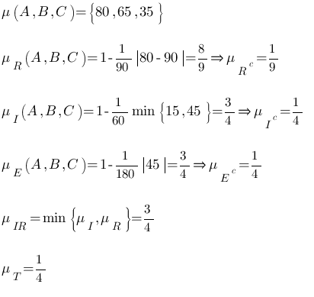
Cont…

Slide 21
Rank Ordering :-
In Rank Ordering method preferences are assigned by a single individual, committee, a poll and other opinion methods can be used to assign membership values to fuzzy variables.
Here preference is determined by pairwise comparisons and these are used to determine ordering of the membership.
For example let’s suppose 10000 people respond to a questionnaire and their pairwise preferences among the colors red, orange, yellow and blue is given as below:

Slide 22
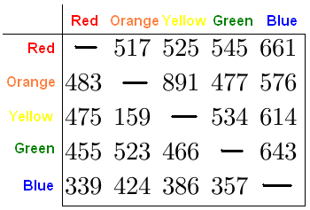
Cont…

Slide 23
Cont…
The color columns in the table represents an anti-symmetric matrix. Such a matrix is used to relate a “reciprocal relation”.

Slide 24
Angular Fuzzy Sets
Angular fuzzy sets differ from normal standard fuzzy sets only in the their coordinate description. Angular fuzzy sets are defined on a universe of angles, hence they are of repeating shapes for every 2π cycles. Angular fuzzy sets are used in the quantitative description of the linguistic variables, which are known as “truth values”.
For example, let’s consider that pH values of water samples are taken from a contaminated pond.
We know that, If pH=7, it is a neutral solution. Levels of pH between 14 and 7 are labeled as absolute basic (AB), very basic (VB), basic, fairly basic (FB), neutral (N) drawn from θ=π/2 to θ=0
Levels of pH between 7 to 0 are called neutral, fairly acidic (FA), acidic (A), very acidic (VA), absolutely acidic (AA), are drawn from θ=0 to θ=(-π/2).
Linguistic values vary with θ and their membership values are given by the equation

Slide 25
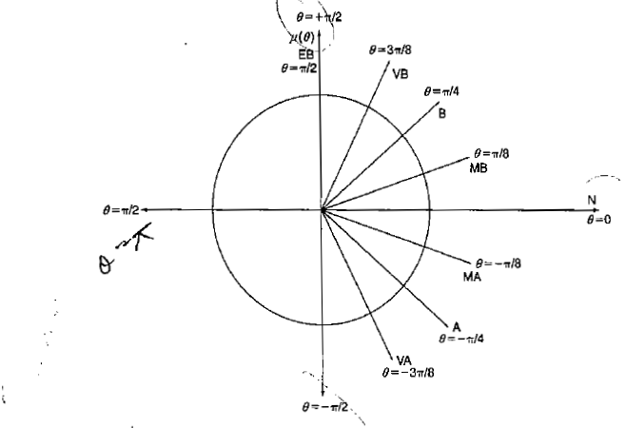
Cont…

Slide 26

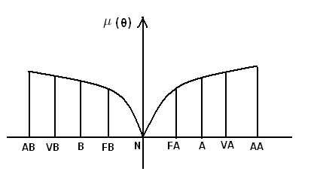
Cont…
here ‘t’ is the horizontal projection of the radial vector.

Slide 27
Cont…
Neural Networks
Genetic algorithms
Inductive reasoning

Slide 28
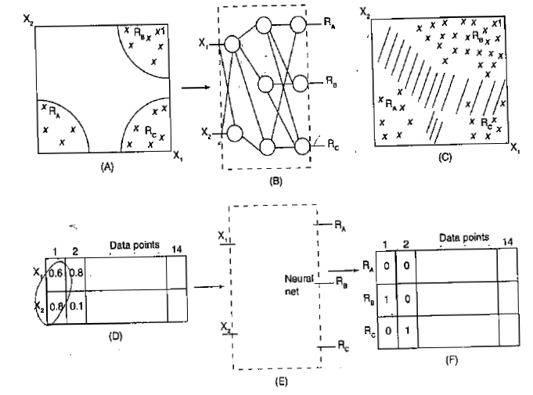
Neural Networks

Slide 29
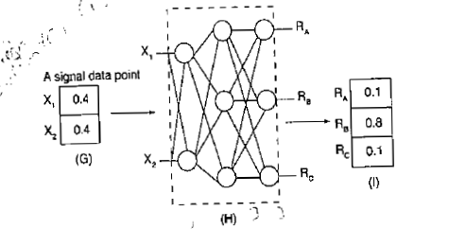

Slide 30
Genetic algorithms
For a particular functional mapping system, the same membership functions and shapes are assumed for various fuzzy variables to be defined.
These chosen membership functions are then coded into bit strings.
Then these bit strings are concatenated together.
The fitness function to be used here is noted.
Evaluate each set of membership functions
These membership functions define the functional mapping of the system

Slide 31
Inductive reasoning
There exist three laws of induction
Given a set irreducibla outcomes of an experiment, the induced probabilities are those probabilities consistent with all available information that maximize the entropy of the set
The induced probability of a set of independent observations is proportional to the probability density of the induced probability of a single observation.
3. The induced rule is that rule consistent with all available information of that minimizes the entropy.

Slide 32
Cont…
The membership function using inductive reasoning are generated as follows
functions using inductive reasoning are generated as follows:
A fuzzy threshold is to be established between classes of data.
Using entropy minimization screening method, first determine the threshold.
Then start the segmentation process.
The segmentation process results into two classes
Again parridoning the first two classes one more time, we obtain three different classes.
The partitioning is repeated with threshold value calculations, which lead Us to partition the data set into a number of classes or fuzzy sets
Then on the basis of shapes, membership function is determined

